Slide 1
CLOUD GATEWAY
Mania Abdi
Rahul Bahal
Chienli Ma
Ayush Singh
Mentors:
Kyle Forster
Ted Elhourani

Slide 2
Background
Private Clouds require extra resources during peak workloads
Borrow resources from public cloud in a hybrid cloud model
Our solution offers a gateway Virtual Machine(s)
Rests on private and scales on demand via cloud burst

Slide 3
The sprint in a Nutshell..
Routed all traffic to the Internet using the VCG
Communicated to the worker in the Private Cloud from the Internet
Established the connection between MOC and AWS
Initiated the design and strategy for Automation

Slide 4
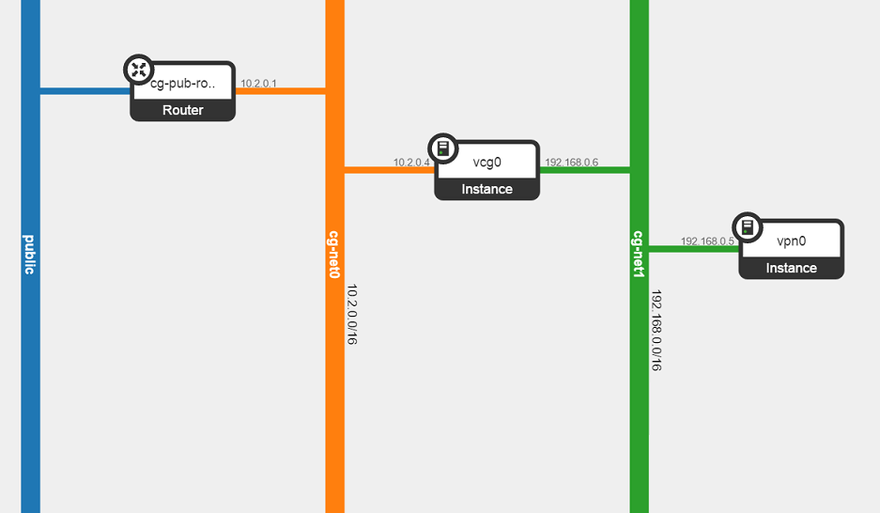
MOC Side Configuration
Configure NAT
Configure Routing Table
Disable Source Checking

Slide 5
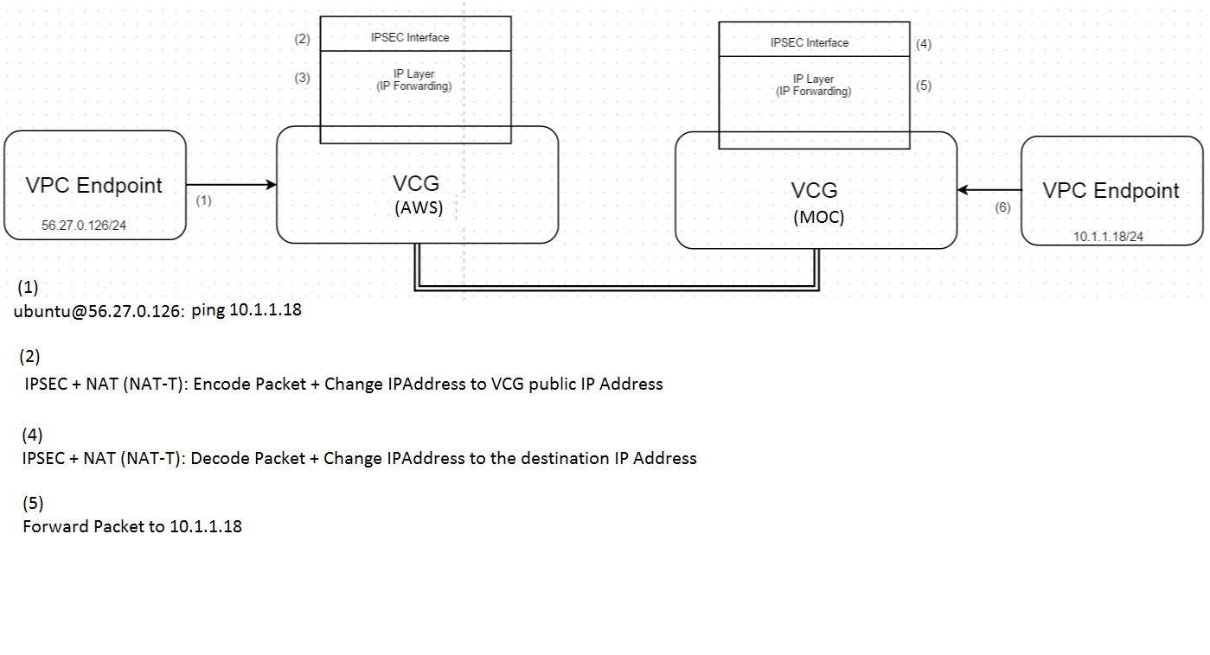
Cloud Gateway Setup – AWS & MOC

Slide 6
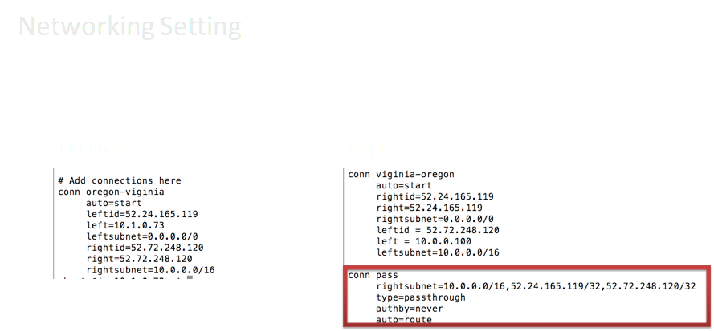

Slide 7
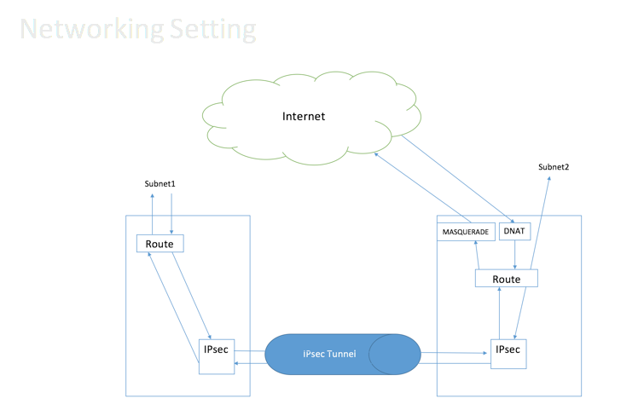

Slide 8
Automation Suite Interface
Add/Delete Connection will create/delete a connection
Connection on/off would toggle connection without affecting the default connection settings
Add left/right subnet will add a CIDR block into the subnet
Enable/Disable internet in case workers need to be accessed from outside

Slide 9
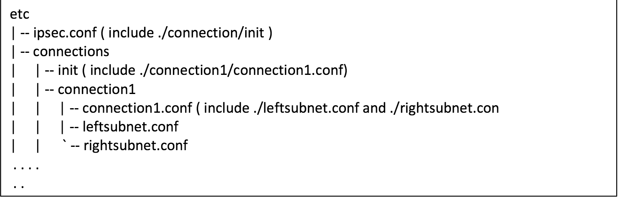
Directory Structure
OpenSwan CLI is implemented by changing config and restarting connections
Enable/Disable internet by changing IP MASQURATE rule in IP tables

Slide 10
TRELLO

Slide 11
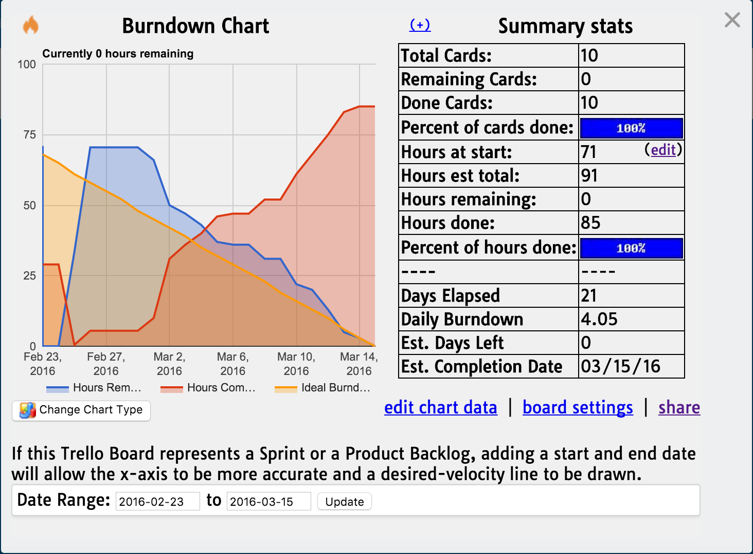

Slide 12
What's Next?
Achieved the last piece of core functionality in this sprint!
Initiate Test Framework Design
UI/CLI for the admin to manage multiple VCGs easily
Automation Suite and packaging

Slide 13
DEMO

Slide 14

Thank you!

